Slide 1
SQL PROJECT WALMARTSSALES PPT
15 TH AUGUST BATCH
DATA SCIENCE
MADE BY RASIKA KANOJIA

Slide 2
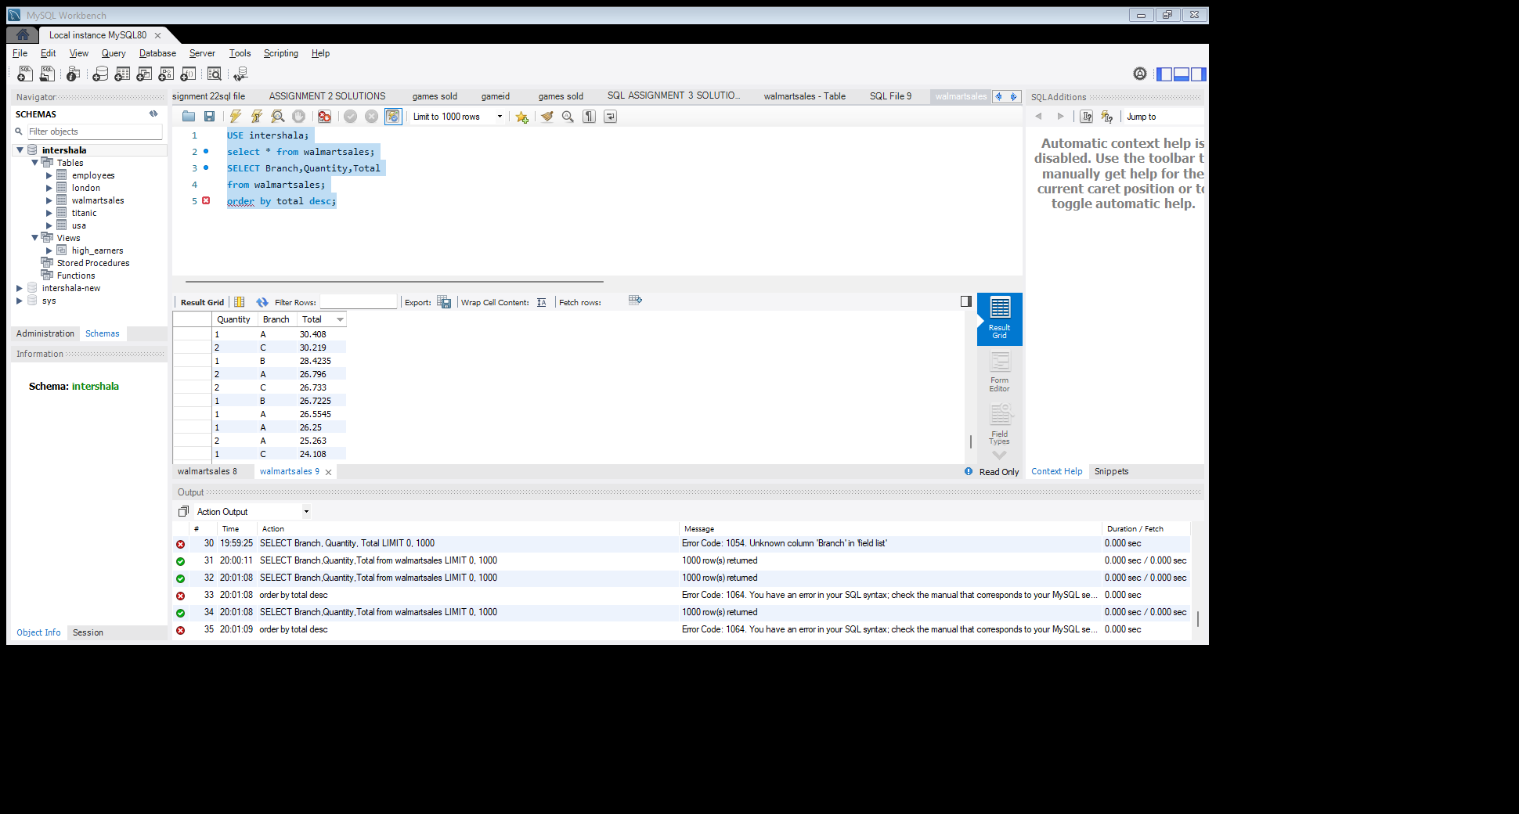
Task 1: Identifying the Top Branch by Sales Growth Rate (6 Marks) Walmart wants to identify which branch has exhibited the highest sales growth over time. Analyze the total sales for each branch and compare the growth rate across months to find the top performer.
USE intershala;
select * from walmartsales;
SELECT Branch,Quantity,Totalfrom walmartsales;order by total desc;

Slide 3
Task 2: Finding the Most Profitable Product Line for Each Branch (6 Marks) Walmart needs to determine which product line contributes the highest profit to each branch.The profit margin should be calculated based on the difference between the gross income and cost of goods sold.
select with_high_profit_branch as
(select Branch, Product_line, quantityfrom walmartsales
where PRODUCT_LINE>51.00)
SELECT * FROM with_high_profit_branch;

Slide 4
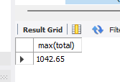


Task 3: Analyzing Customer Segmentation Based on Spending (6 Marks) Walmart wants to segment customers based on their average spending behavior. Classify customers into three tiers: High, Medium, and Low spenders based on their total purchase amounts.
SELECT * FROM walmartsales;
select max(total) from walmartsales;
select * from walmartsales;
select min(total) from walmartsales;
select * from walmartsales;
select avg(total) from walmartsales;

Slide 5
Task 4: Detecting Anomalies in Sales Transactions Walmart suspects that some transactions have unusually high or low sales compared to the average for the product line. Identify these anomalies.
Insert: This command is used to insert data into tables.
Update: This command is used to renew existing data of the tables.
Delete: This command is used to delete certain data from table based on conditions.

Slide 6
Task 5: Most Popular Payment Method by City (6 Marks) Walmart needs to determine the most popular payment method in each city to tailor marketing strategies.
select * from walmartsales;
SELECT City, Payment,
row number() over(partition by city order by Payment) as rn
from walmartsales;

Slide 7
Task 6: Monthly Sales Distribution by Gender (6 Marks) Walmart wants to understand the sales distribution between male and female customers on a monthly basis.
select * from walmartsales;
select count(*) from walmartsales;
select count(male) from walmartsales;
select count(female) from walmartsales;

Slide 8
Task 7: Best Product Line by Customer Type (6 Marks) Walmart wants to know which product lines are preferred by different customer types(Member vs. Normal).
use walmartsales;
select * from walmartsales;
select Product_line from walmartsales
where customer_type(select member(normal) from walmartsales);

Slide 9
Task 8: Identifying Repeat Customers (6 Marks) Walmart needs to identify customers who made repeat purchases within a specific time frame (e.g., within 30 days).
use walmartsales;
select * from walmartsales;
SELECT CUSTOMER_TYPE,
Count(customer_type) as time from walmsrtsales group by customer_type having count(customer_type)

Slide 10
Task 9: Finding Top 5 Customers by Sales Volume (6 Marks) Walmart wants to reward its top 5 customers who have generated the most sales Revenue.
select * from walmartsales;
SELECT Branch,Quantity,Totalfrom walmartsales;
order by total desc;

Slide 11
Task 10: Analyzing Sales Trends by Day of the Week (6 Marks) Walmart wants to analyze the sales patterns to determine which day of the week brings the highest sales.
select * from walmartsales;
SELECT City, Payment,row number() over(partition by city order by Payment) as rnfrom walmartsales;

